Slide 1
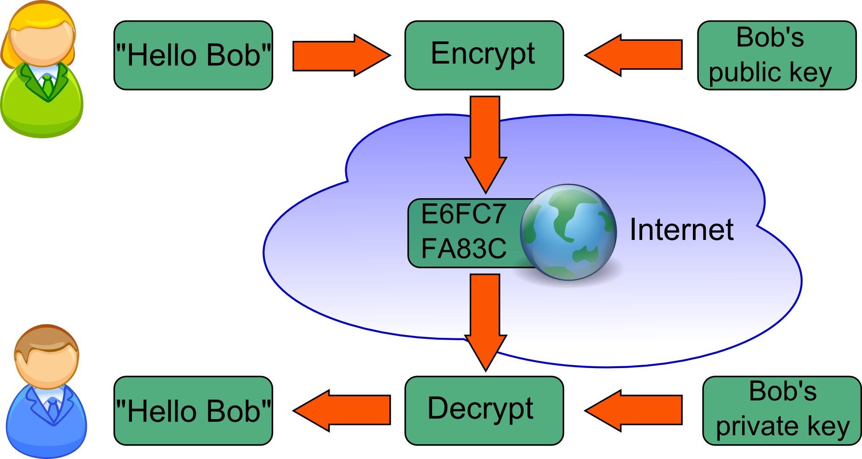
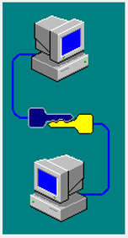
Public / Private Key Encryption

Slide 2
Public / Private Key Encryption
777

Slide 3


My SSN: 123-45-6789
123456789 777 = 158889.046332046332
158889.046332
158889.046332 x 777
= 123456788.999964
~ 123456789‬‬
jhetrick@pacific.edu
Or just call me.
Cell: 209-518-7835

Slide 4
University of the Pacific
San Joaquin County Office of Educcation
Delta Sierra Science Project
AI Bootcamp
Day 1: 15 June 2020

Slide 5
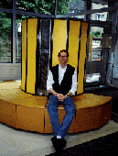
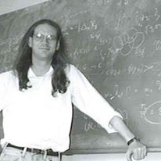
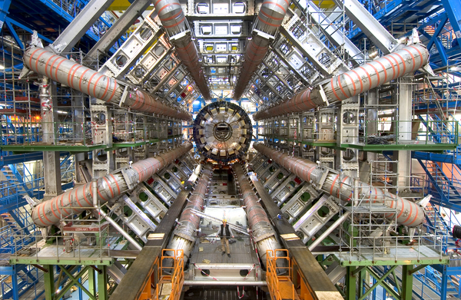
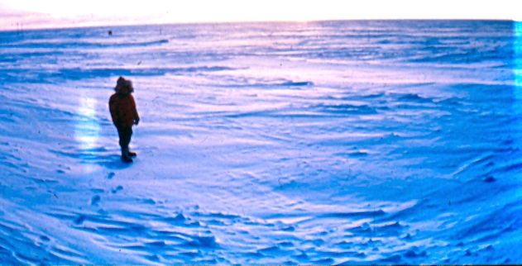
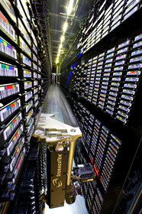
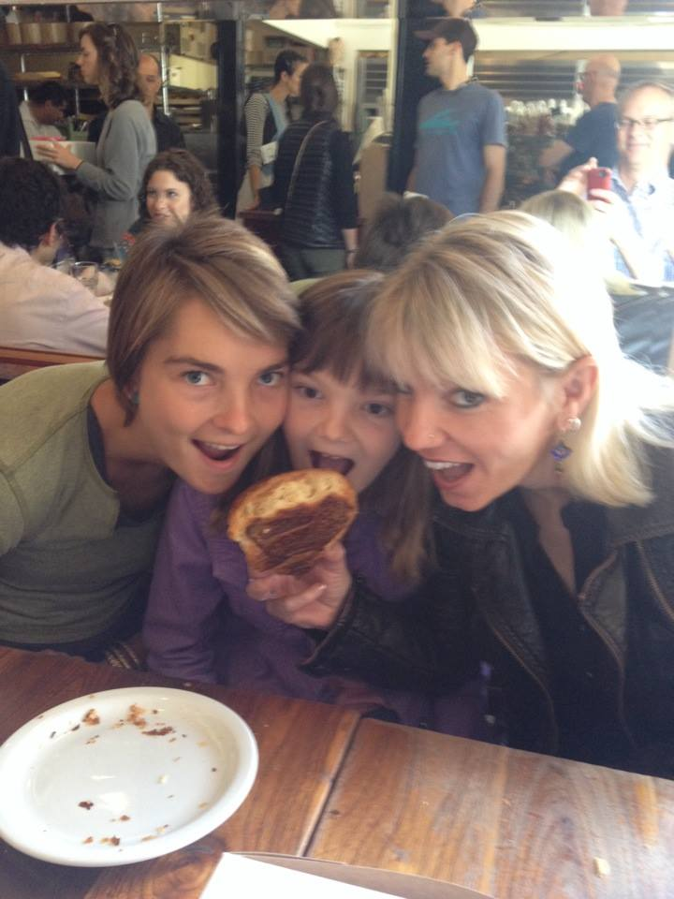
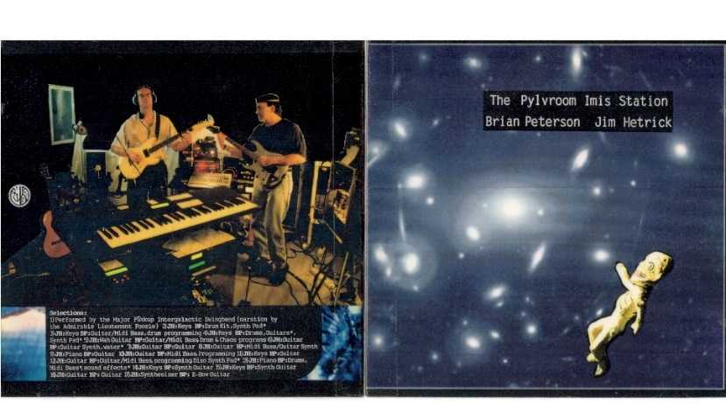
Dr. Jim Hetrick
Physics +
Data Science
University of the Pacific

Slide 6
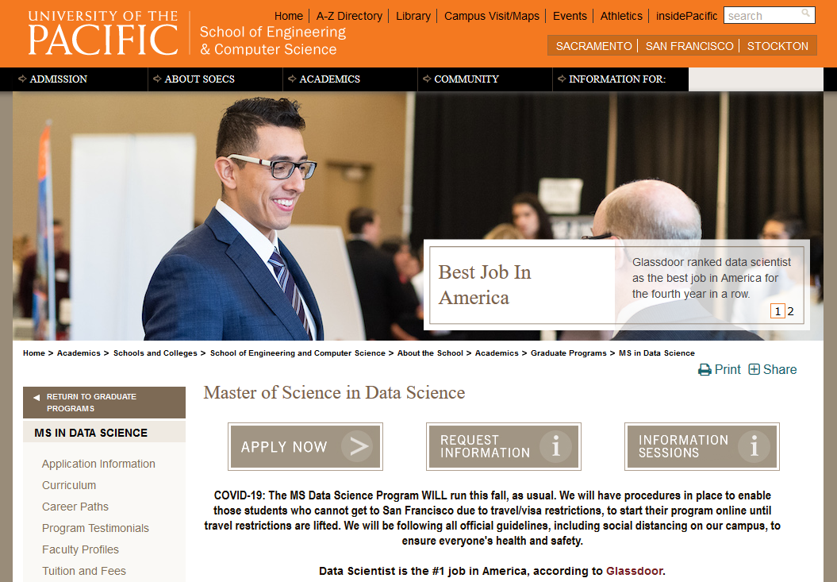

Slide 7
Educating Data Scientists
Semester I Semester II Semester III Semester IV
Data Engineering
Time Series Analysis
NoSQL Databases
Customer Analytics
Emphasis Case Studies
Visual Story Telling
Analytic Hot Topics
Frequentist Statistics
Linear Algebra
Analytic Computing
Relational Databases
Research Methods
Analytic Hot Topics
Bayesian Statistics
Data Wrangling
Machine Learning
Intro to Visualization
Healthcare Case Studies
Software Methods
Analytic Hot Topics
Fraud Detection
Dynamic Visualization
CAPSTONE PROJECT
Notes:
We are entering a new era: the Data era
Silicon Valley has been the world leader for technology over the past 50 years (and will continue to do so through companies like Cisco)
IOT is spawning the Big Data / Analytics era – and we need new skills
San Francisco & the bay area need to become not only the place where the world looks for technological innovation, but also the place to look for the skills and the knowhow of how to manage the data era

Slide 8





Capstone Projects
Capstone Projects
You will complete a capstone project which will allow you to apply what you have learned, and gain hands-on experience on a real project with a major Bay Area / northern California company, such as:
Notes:
We are entering a new era: the Data era
Silicon Valley has been the world leader for technology over the past 50 years (and will continue to do so through companies like Cisco)
IOT is spawning the Big Data / Analytics era – and we need new skills
San Francisco & the bay area need to become not only the place where the world looks for technological innovation, but also the place to look for the skills and the knowhow of how to manage the data era

Slide 9
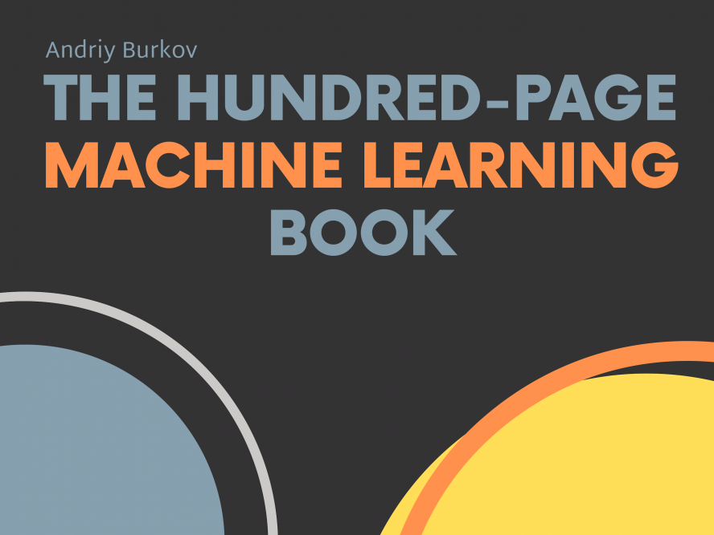
http://themlbook.com/wiki/doku.php
For PDF Chapters
http://themlbook.com/

Slide 10

What is Artificial Intelligence?
Artificial Intelligence

Slide 11
What is Artificial Intelligence?
Artificial Intelligence

Slide 12
What is Artificial Intelligence?
Artificial Intelligence
Machine Learning
Regression
Clustering
Decision Trees
Dimensional Reduction
Neural Networks
(Deep Learning)
“Machine learning …explores the study and construction of algorithms that can learn from and make predictions on data”
Source: Wikipedia

Slide 13
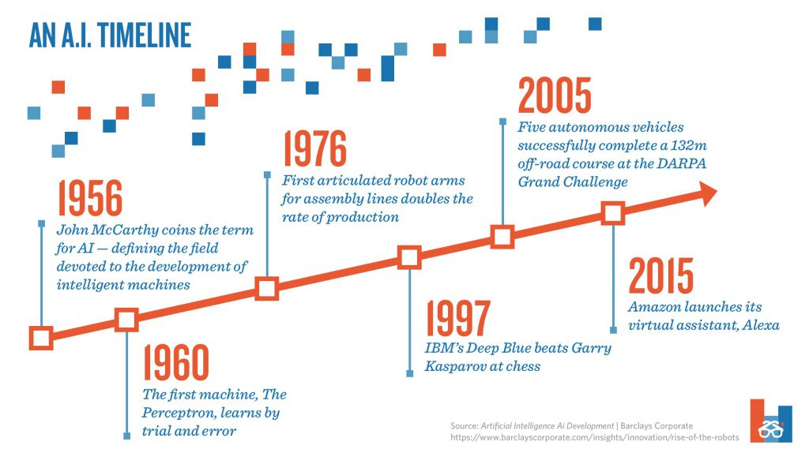

Slide 14
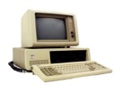
Information Era Timeline
email common
in academia, government,
and military
1980
1990
2000
2010
2020

Slide 15
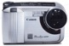
Information Era Timeline
email common
in academia, government,
and military
Consumer
digital
photography
1980
1990
2000
2010
2020

Slide 16


Information Era Timeline
World Wide Web
(introduced at
CERN)
email common
in academia, government,
and military
Consumer
digital
photography
1980
1990
2000
2010
2020

Slide 17

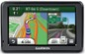
Information Era Timeline
World Wide Web
email common
in academia, government,
and military
Consumer
digital
photography
Civilian
GPS
1980
1990
2000
2010
2020

Slide 18

Information Era Timeline
Netflix:
DVDs
World Wide Web
email common
in academia, government,
and military
Consumer
digital
photography
Civilian
GPS
1980
1990
2000
2010
2020

Slide 19

Information Era Timeline
Netflix:
DVDs
World Wide Web
email common
in academia, government,
and military
Consumer
digital
photography
Civilian
GPS
iPod
1980
1990
2000
2010
2020

Slide 20
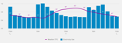
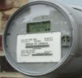



Information Era Timeline
Smart meters in CA
Netflix:
DVDs……….streaming
World Wide Web
email common
in academia, government,
and military
Consumer
digital
photography
Civilian
GPS
iPod
1980
1990
2000
2010
2020

Slide 21
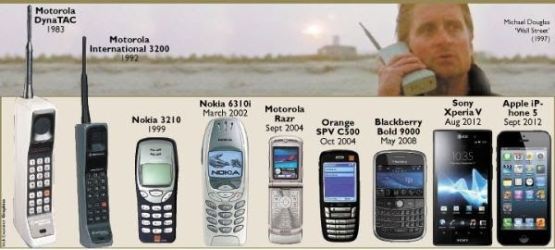
Information Era Timeline
Meanwhile…
1980
1990
2000
2010
2020

Slide 22

Information Era Timeline
Smart meters in CA
Netflix:
DVDs……….streaming
World Wide Web
email common
in academia, government,
and military
Consumer
digital
photography
Civilian
GPS
iPod
iPhone
1980
1990
2000
2010
2020

Slide 23

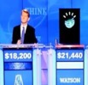
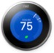


Information Era Timeline
Smart meters in CA
Neural Net
recognizes
cats
Netflix:
DVDs……….streaming
World Wide Web
Watson wins
Jeopardy
email common
in academia, government,
and military
Nest
Consumer
digital
photography
Civilian
GPS
Siri
iPod
iPhone
Fitbit
1980
1990
2000
2010
2020

Slide 24
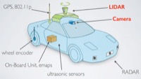
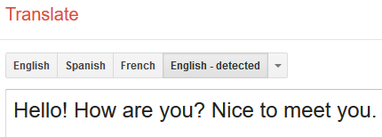


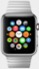
Information Era Timeline
Smart meters in CA
Neural Net
recognizes
cats
Netflix:
DVDs……….streaming
World Wide Web
Autonomous
Vehicles
Watson wins
Jeopardy
email common
in academia, government,
and military
Nest
Google Translate
Consumer
digital
photography
Civilian
GPS
Siri
Apple
Watch
Amazon Echo
iPod
iPhone
Fitbit
1980
1990
2000
2010
2020

Slide 25
Information Era Timeline
Smart meters in CA
Neural Net
recognizes
cats
Netflix:
DVDs……….streaming
World Wide Web
Autonomous
Vehicles
Watson wins
Jeopardy
email common
in academia, government,
and military
Nest
Google Translate
Consumer
digital
photography
Civilian
GPS
iPod
iPhone
Apple
Watch
Amazon Echo
Fitbit
1980
1990
2000
2010
2020

Slide 26
Information Era Timeline
Smart meters in CA
Neural Net
recognizes
cats
Netflix:
DVDs……….streaming
World Wide Web
introduced at
CERN
Autonomous
Vehicles
Watson wins
Jeopardy
Digital Age: text, image, sound, etc. digitized
email common
in academia, government,
and military
Nest
Google Translate
Consumer
digital
photography
Civilian
GPS
Siri
Apple
Watch
Amazon Echo
iPod
iPhone
Fitbit
1980
1990
2000
2010
2020

Slide 27
Information Era Timeline
Smart meters in CA
Neural Net
recognizes
cats
Netflix:
DVDs……….streaming
Autonomous
Vehicles
Internet Age: WWW connects everything
World Wide Web
introduced at
CERN
Watson wins
Jeopardy
Digital Age: text, image, sound, etc. digitized
email common
in academia, government,
and military
Nest
Google Translate
Consumer
digital
photography
Civilian
GPS
Siri
Apple
Watch
Amazon Echo
iPod
iPhone
Fitbit
1980
1990
2000
2010
2020

Slide 28
Information Era Timeline
Smart meters in CA
Neural Net
recognizes
cats
Data Age:
ubiquitous, granular,
digitally stored
Netflix:
DVDs……….streaming
Autonomous
Vehicles
Internet Age: WWW connects everything
World Wide Web
introduced at
CERN
Watson wins
Jeopardy
Digital Age: text, image, sound, etc. digitized
email common
in academia, government,
and military
Nest
Google Translate
Consumer
digital
photography
Civilian
GPS
Siri
Apple
Watch
Amazon Echo
iPod
iPhone
Fitbit
1980
1990
2000
2010
2020

Slide 29
Information Era Timeline
Smart meters in CA
Neural Net
recognizes
cats
Machine Learning / A.I.
Data Age:
ubiquitous, granular,
digitally stored
Netflix:
DVDs……….streaming
Autonomous
Vehicles
Internet Age: WWW connects everything
World Wide Web
introduced at
CERN
Watson wins
Jeopardy
Digital Age: text, image, sound, etc. digitized
email common
in academia, government,
and military
Nest
Google Translate
Consumer
digital
photography
Civilian
GPS
Siri
Apple
Watch
Amazon Echo
iPod
iPhone
Fitbit
1980
1990
2000
2010
2020

Slide 30
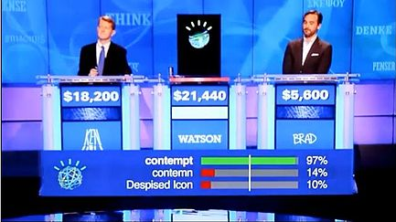
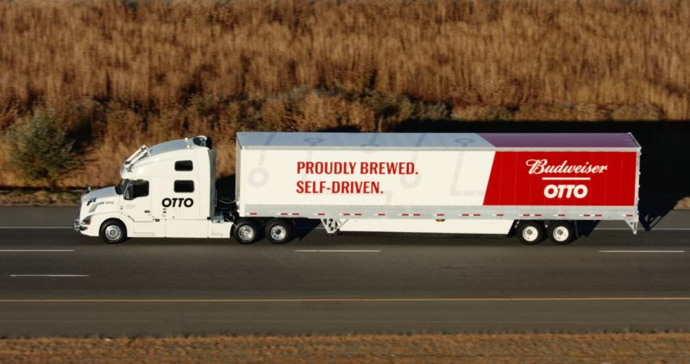
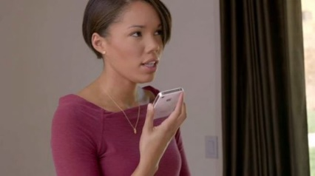
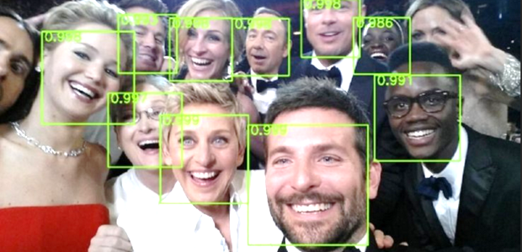

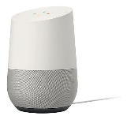
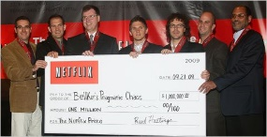
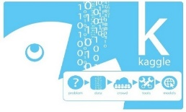
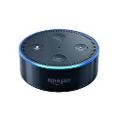
Advances in Machine Learning
Watson wins Jeopardy
Autonomous vehicles
Siri
Face recognition
Chatbots
Voice-enabled Home Assistants
Netflix Prize
Kaggle
2005
2010
2015
2020

Slide 31
Advances in Machine Learning
Image/Pattern Recognition
Classification
Identification
Prediction
Watson wins Jeopardy
Autonomous vehicles
Siri
Face recognition
Chatbots
Voice-enabled Home Assistants
Netflix Prize
Kaggle
2005
2010
2015
2020

Slide 32
Advances in Machine Learning
Image/Pattern Recognition
Classification
Identification
Prediction
Watson wins Jeopardy
Autonomous vehicles
Natural Language Processing (NLP)
Speech Recognition
Language Translation
(“good enough”)
Meaning analysis
Siri
Face recognition
Chatbots
Voice-enabled Home Assistants
Netflix Prize
Kaggle
2005
2010
2015
2020

Slide 33
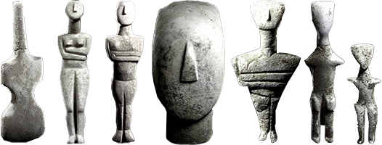
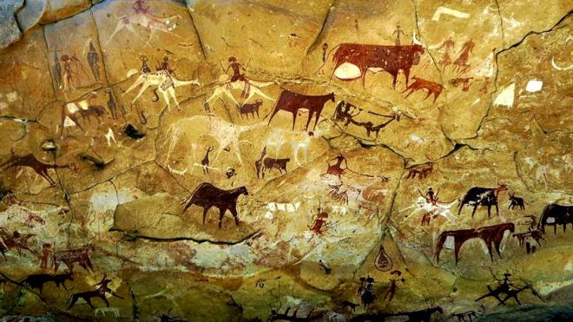
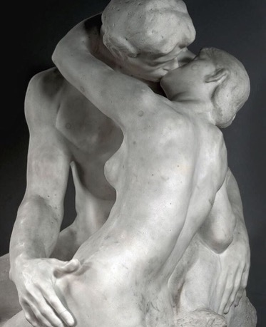
Models
Models make us human

Slide 34
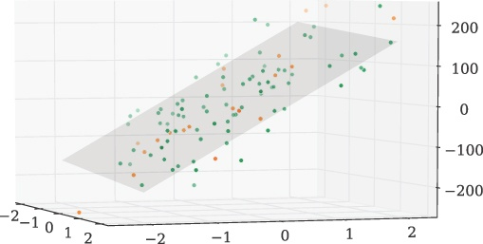
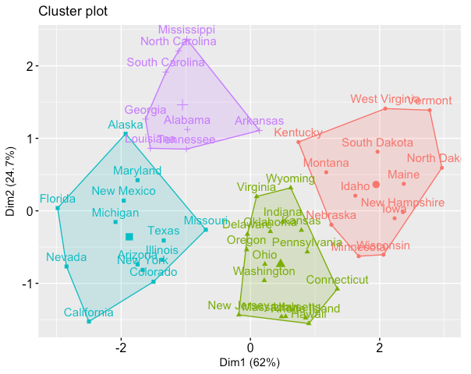
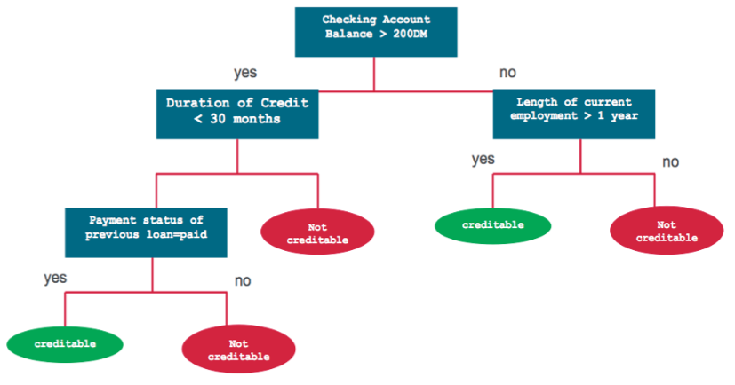
Models Machine Learning
Fundamentally, machine learning
is about making models

Slide 35
Models Machine Learning
Fundamentally, machine learning
is about making models
Regression
K-Nearest
Neighbors
Decision
Tree

Slide 36
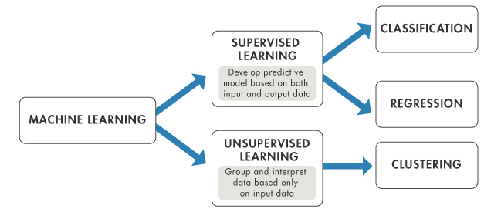
Two Basic Types of Machine Learning

Slide 37
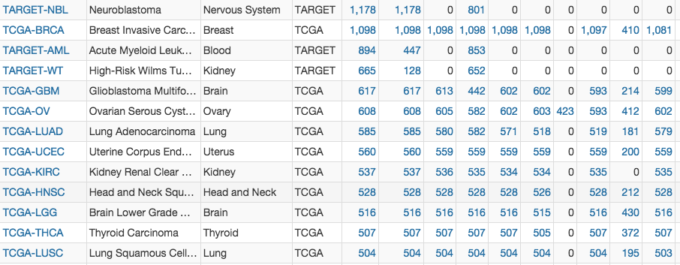
Machine Learning - Supervised
For Predictive outcomes
Data has many features (zip code, age, income, etc.)
Training data has labels, so that the system can learn to predict the correct label of new (unlabeled) data.
The goal is to create a model that can predict the correct label from new data.
Yes
No
Yes
Yes
Yes
No
No
Yes
No
Yes
Yes

Slide 38
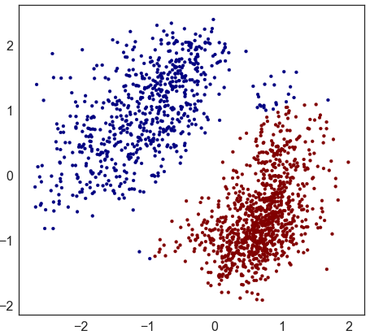
Machine Learning - UnSupervised
For Descriptive outcomes (think: Data Mining)
The computer is NOT provided with training data.
The learning algorithm is left to search for statistically significant patterns in the data, and describe what it finds

Slide 39
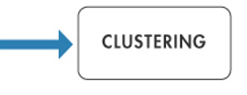
Two Basic Types of Machine Learning
PREDICTION

Slide 40


Two Basic Types of Machine Learning
PREDICTION

Slide 41

Data
Target / labels
Yes
No
Yes
Yes
Yes
No
No
Yes
No
Yes
Yes
Supervised
Data
Unsupervised

Slide 42
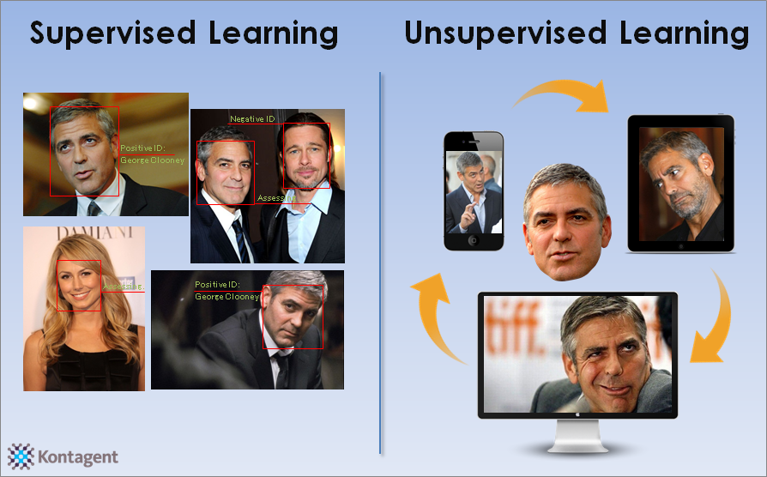
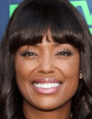


✓
✗
✓
✗
✓

Slide 43
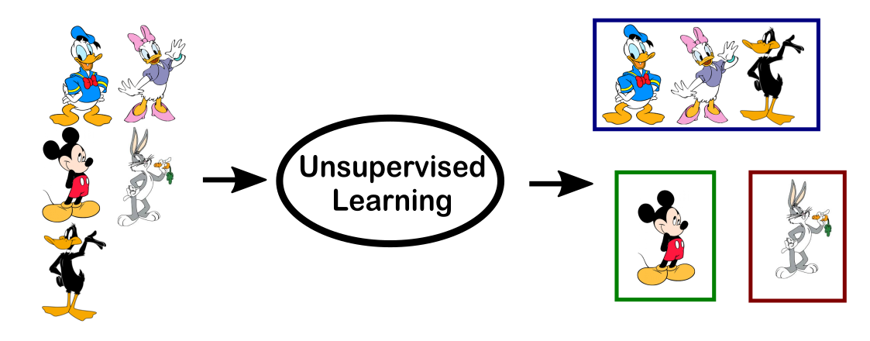
Supervised or UnSupervised What Characters?
?

Slide 44
UnSupervised What Characters?

Slide 45
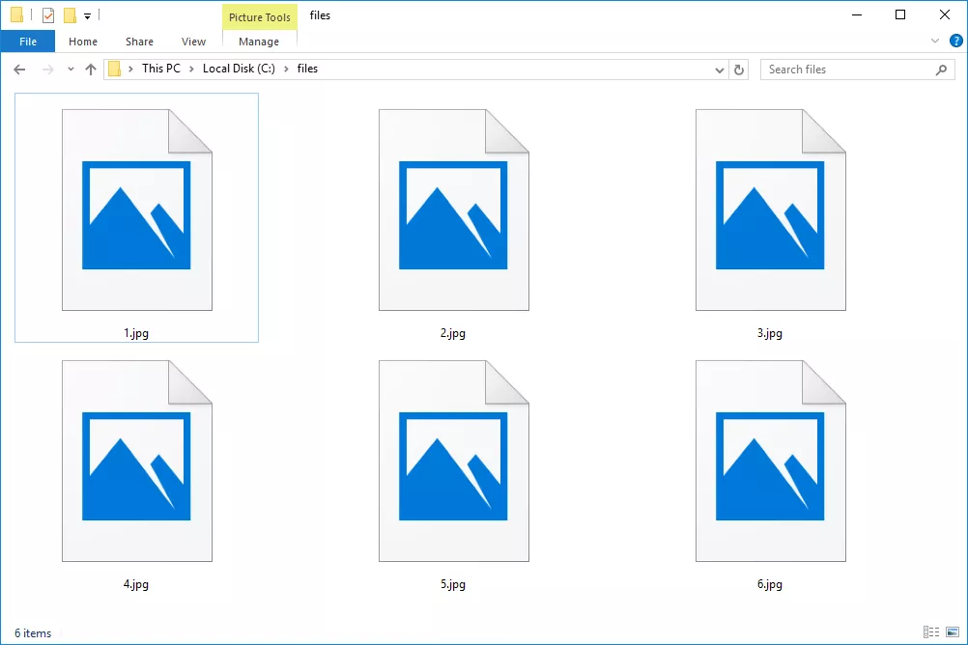
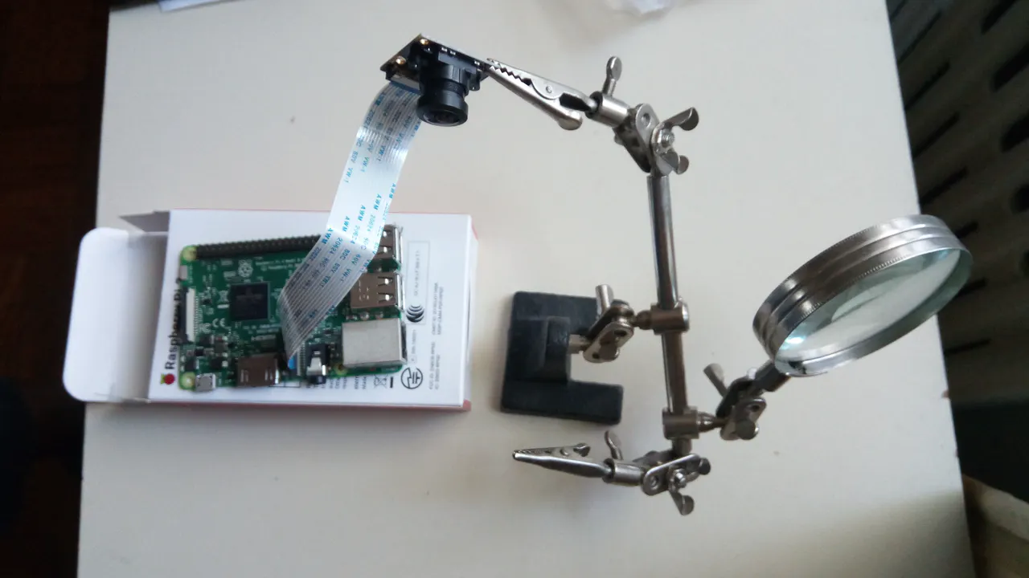

Example: Handwriten Digit Recognition
7
5
3
5
3
4
?

Slide 46
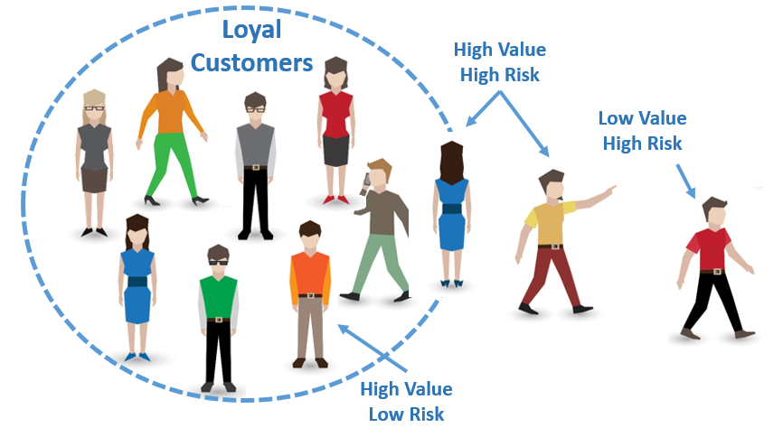
Supervised or UnSupervised Customer Churn

Slide 47
Supervised Customer Churn

Slide 48
Your models...
Students?
Teachers?
Fundraising?
Performance?
…

Slide 49
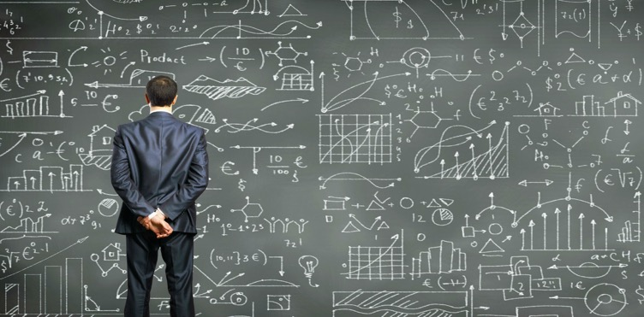
What Data do you NEED?
Your models...

Slide 50
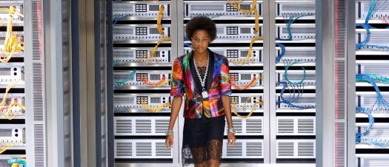
What Data do you NEED?
Your models...
What Data do you HAVE?

